Slide 1
Phylogenomics reveals multiple losses of nitrogen-fixing root nodule symbiosis - Griesmann et al.
EEOB546X Final Project, Jacob Stai

Slide 2
Overview of paper: Background
Legumes can make their own fertilizer using a special organ called a nodule.
Nodules work because symbiotic bacteria have the enzymes needed to fix nitrogen.
But these bacteria need anaerobic conditions for optimal function; the plant gives that to them in the nodule.
Nodules form when:
Symbiotic bacteria excrete Nod factors, which are detected by receptors on the root / root hair.
The signal passes into the cell to a calcium signalling pathway shared with other symbiotic pathways.
Calcium signalling triggers changes in hormones throughout the plant which lead to initiation of a nodule in the deep root tissue. Stem tissue is involved. It’s complicated.
A set of core transcription factors mediate the initiation of nodulation, including NIN.
Two theories around when nodulation evolved:
Once, at the base of the nitrogen-fixing clade
Multiple times, but only in the various closely-related nitrogen-fixing clades

Slide 3
Overview of paper: Findings
Core conclusion: That nitrogen-fixing nodule symbiosis was lost multiple times
Though they didn’t state it outright in the paper, they’re heavily implying that it also arose only once.
There were no genes that they found to have been gained in the most recent common ancestor of the NFN clade that they found to have been conserved or lost irrespectively of the symbiotic state of the lineages. Not one single one of their gene families matched the expected phylogenetic pattern of arising at the base of the NFN clade, and then being selectively retained in nodulators and not in non-nodulators.
This rules out a “simple predisposition” model, where a single predisposing mutation arose that allowed only the NFN clade to evolve nodulation, and made that evolution so much easier that it could happen by chance..

Slide 4
Overview of paper: Steps They Did
Sequenced genomes from a wide variety of nodulating and non-nodulating NFN clade members.
Assembled them and annotated them.
Clustering of predicted proteomes of the gene annotation into gene families.
Phylogeny-based ortholog presence/absence analysis.
Analysis of gene copy number variation.
Synteny analysis.
Analysis for detection of selection pressure on gene trees.
This is the one I’m replicating.

Slide 5
Overview of paper: Analysis Replicated
Start with protein sequences.
Align using MAFFT.
Take codon sequences.
Use protein alignments as matrix to generate codon alignments using pal2nal.
Run maximum likelihood analysis with 10,000 Ultrafast bootstrap replicates using IQ-TREE.
“Control unrooted tree to fit the evolutionary frame of species.”
Test the hypothesis that the NFN clade may have a proportion of sites under positive selection using codeml from PAML.

Slide 6
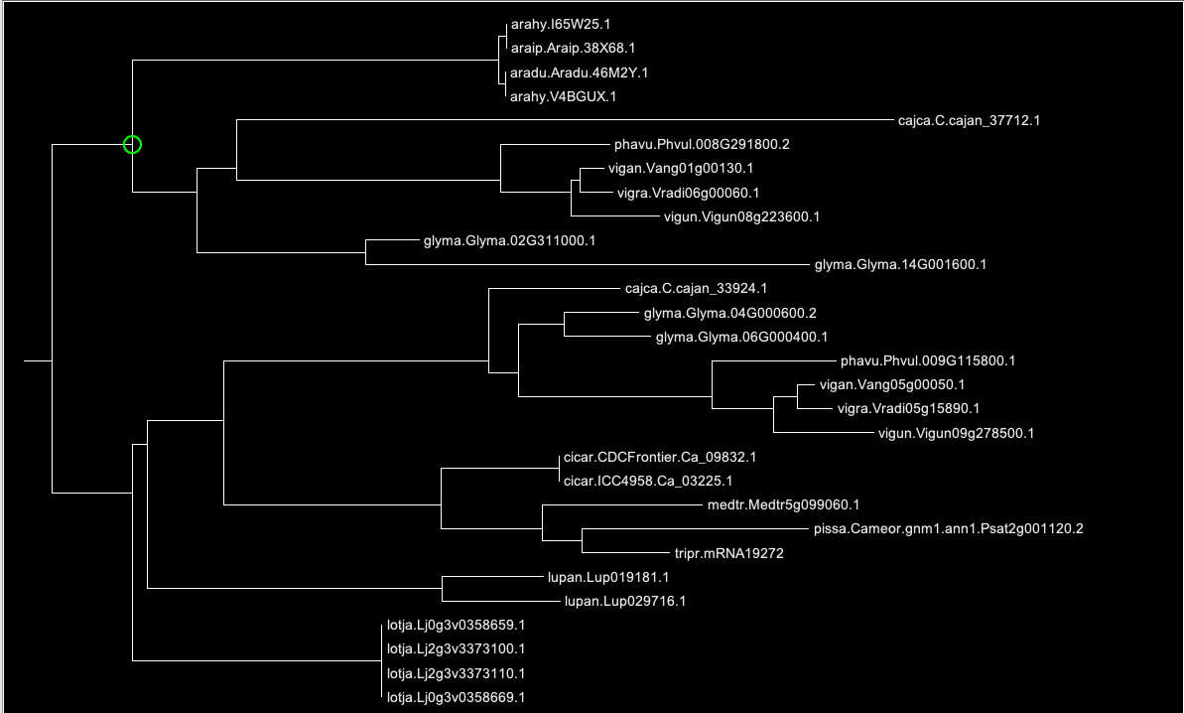
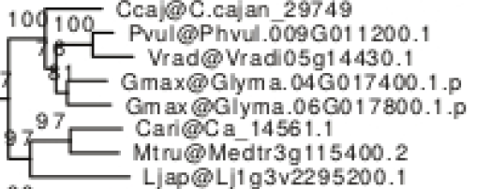
Figures Replicated:
Gene tree of NIN family:
Mine →
Theirs 🠓

Slide 7
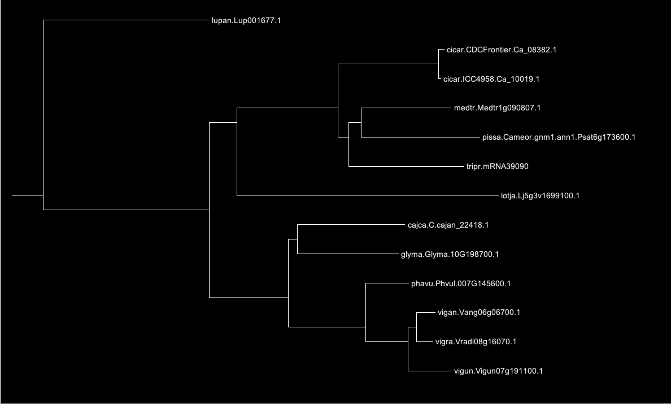
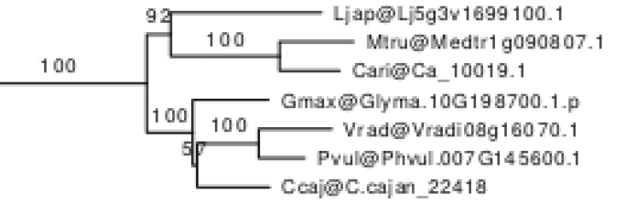
Figures Replicated:
Gene tree of RPG family:
Mine →
Theirs 🠓

Slide 8
Process: Challenges: The Big One
Poor availability of the sequences that they used for their analysis
Sequences for the NIN and RPG families were available from other databases, but they had sequenced a large number of new genomes.
The sequences which they extracted from those genomes were not made available.
Raw reads were made available, but this would have required the user to go through the entirety of the genome assembly process and go through the entirety of the genome-annotation process in order to get only a facsimile of which sequences in particular it was that they used.

Slide 9
Process: Challenges: Other
Unclear instruction on how they rooted their trees to control for species relationships
Manual rooting is thought by me to be the method used, based on author’s familiarity with similar analyses, but I remain uncertain.
No automatic methods for rooting an unrooted gene tree by a known species tree is known to us; this is an inherent gap in the bioinformatics landscape right now.
Full instruction set was not given in description for programs with many options
Default values were assumed to have been used when not specified; however, without specification, if future versions should ever change this value, replications based on this assumption will be wrong.
Description of PAML use didn’t make explicit that they were using codon seqtype
This was inferable from the program’s refusal to run with default setting, without changing that parameter.
Greater familiarity with program and calculation may have made that obvious; unclear to us.

Slide 10
Process: Takeaways
Always give readers access to the scripts you used to do your work.
Even if this is not possible, there are ways to specify your work that are more helpful than others.
Always if possible give full specification for option parameters, even if you think it’s obvious which one you should use, especially if you’ve changed any default settings.
Always provide protein and nucleotide sequences, or, if only one may be given for space reasons, pick CDS over protein.
Always give full step-by-step descriptions of your methods
Descriptions such as “controlled trees to fit species context” may seem obvious to you, but help no one.
If your methods cannot be communicated to someone else, maybe they’re not replicable methods, at least not until you make them replicable, by documenting your actions.

